Slide 1


Food Safety Nutrition.
Edyta Margas.
Innovations for a better world.

Slide 2
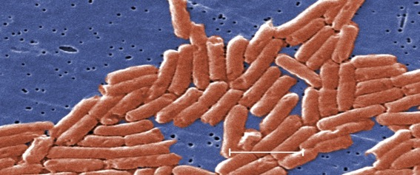

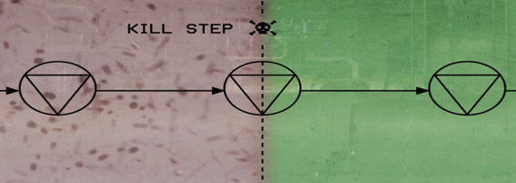




Safety of low water activity foods has become new priority for the food industry and regulatory bodies.
Increased human health problems
Salmonella in dry food
1 µm
Janice Haney Carr, Centers for Disease Control and Prevention, USA
Need of a validated kill step
New regulations &
Private standards
Notes:
Salmonella in dry foods:
Heat resistant
Can survive years in dry conditions
Small amount can cause illness
FSMA – proposed 2011, final rule accepted 2015, implemented by 2018

Slide 3
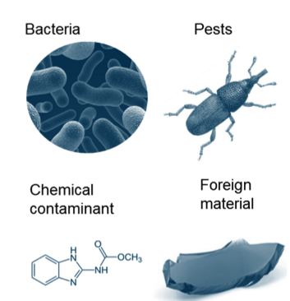
Food safety hazard for extruded products.
47% recalls in USA come from microbial contamination
Biological hazards:
Pathogenic bacteria* & viruses like Salmonella, Listeria, E. coli. Bacillus cereus, Norovirus, etc.
Pest like insects, rodents and birds.
Chemical hazards: edyta.margas@buhlergroup.com
Naturally formed toxins (e.g. mycotoxins from molds)
Undeclared allergens
Chemicals from the environment (e.g. pesticides)
Chemicals introduced in processing (e.g. lubricants)
Toxic compounds formed during processing (e.g. acrylamide*)
Intentional adulteration (e.g. banned additives like KBr)
Physical hazards:
Foreign material like glass, metal, plastic, wood, etc.
Notes:
pathogenic bacteria: means that the microorganism can infect or intoxicate humans or animals, in other words, the bacteria are harmful.
Acrylamide: Roasting of coffee, baking of cookies or frying of potato chips are processes where acrylamide may be formed. Acrylamide is considered a cancerogenic compound and industry has to apply mitigation strategies minimize the level of acrylamide. Reducing thermal impact, i.e. temperature, is the most effective method to reduce acrylamide formation.

Slide 4
Outbreaks associated with cereals (WHO/FAO, 2015).
Cereal or Grain Product | Microbial hazard(s) | Cases | Country (year)
Toasted Oat Cereal | Salmonella Agona | 209 | United States (1998)
Puffed Rice Cereal | Salmonella Agona | 33 | United States (2008)
Infant Cereal | B. cereus | 2 | United Kingdom (2005)
 | Salmonella Senftenberg | 5 | United Kingdom (1995)
Cereal products plus rice and seeds/pulses/nuts | B. cereus | 46 | France (2011), France (2012), Switzerland (2012)
 | S. aureus | 11 | France (2009, 2011)
Bulgur | B. Cereus (temp. abuse) | 21 | Finland (2010), Denmark (2011)
Buckwheat | B. cereus | 52 | Poland (2009)
Flour (uncooked product) | Salmonella Typhimurium | 67 | New Zealand (2008)
 | E. coli O121 (frozen dough) | 35 | United States (2013)
Unspecified Grains | Salmonella Lika | 3 | United States (2003)
Rice Cake | E. coli (STEC) | 142 | Japan (2011)
Cooked Rice | B. Cereus (temp. abuse) | 382
 | S. aureus | 52 | France (2001), Australia (2002), Portugal (2011)
 | C. perfringens | 23 | Australia (2005)
 | Salmonella Typhimurium | 2 | Australia (2010)
Cooked Pasta | B. cereus | 50 | Belgium (2004), US (2009), Germany (2012)
 | C. perfringens | 330 | Australia (2004), US (2004, 2009, 2010)
 | Salmonella | 44 | Austria (2005), United States (1996, 2004)
 | S. aureus | 98 | France (1988), US (1995, 1999, 2008), Belgium (2009)
Rice Noodles | S. aureus | 3 | Australia (2010)

Slide 5
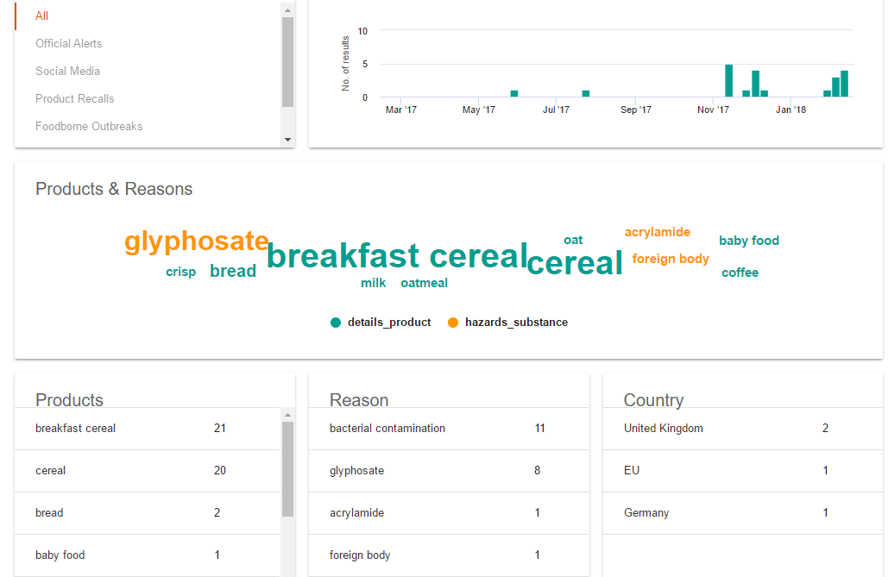
News associated with contaminated breakfast cereals 2017.
Bühler Food Safety Intelligence - Safefood.ai.

Slide 6
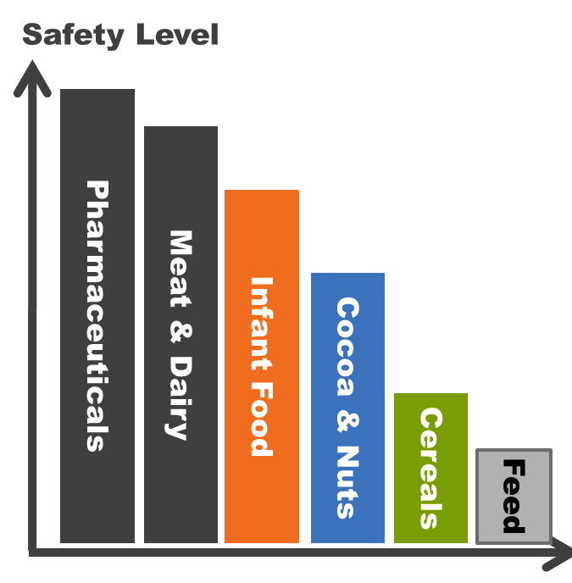
Trend: “Feed goes food and food goes pharma”.
Closing the gap:
hygienic design
Inactivation processes
monitoring & validation

Slide 7

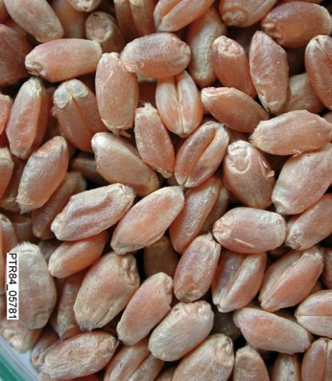

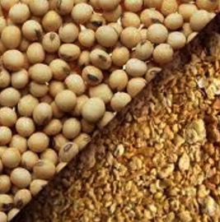
Food Safety measures.
Ensure
top hygiene
Safeguard raw material quality
Implement
a trusted
microbial
kill step
Notes:
Who would have thought 10 years ago, that bacteria like Salmonella could also become the game changer for the dry-plant based food.
Today we know, that Salmonella can be present and survive for years on dry nuts, cereals, soy, spices.
And food and feed manufacturer need to apply preventive measures to ensure that the Salmonella don’t slip though to end consumers.
The way to control Salmonella in ready-to-eat food processing is: safeguard the raw material quality, implement a trusted kill step, and ensure GMP with good hygiene,

Slide 8
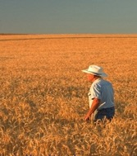
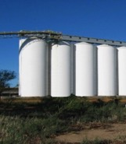

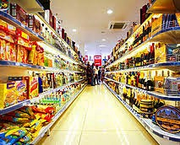
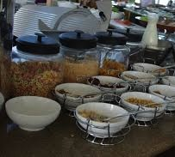

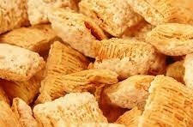
Food Safety concerns all actors along the value chain.
Pressure to act builds up from the end product / consumer side.
farmers traders agro-food food retailers caterers consumers/
convertors processors society

Slide 9
Bühler Food Safety Initiative.

Slide 10



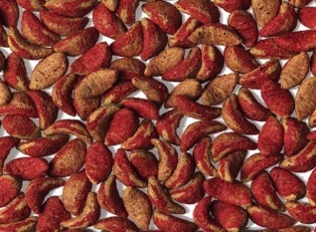


Our Food Safety mission.
Harness Science
& Technology to enable safe food and feed processing across the food value chain.
Notes:
Bühler enables
safe feed & food processing
with technologies & services
for good hygiene,
reliable decontamination
and full traceability
to build trust in the
grain-feed-food value chain.

Slide 11
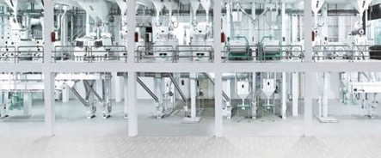
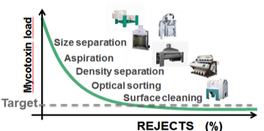

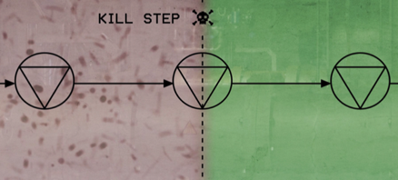
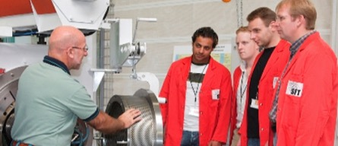

Bühler: Leading the food safety challenge.
Hygienic design of plant and machines
Building credibility
1 µm
Building intelligence into processing for safety
Know how, education and training
Notes:
Salmonella in dry foods:
Heat resistant
Can survive years in dry conditions
Small amount can cause illness
FSMA – proposed 2011, final rule accepted 2015, implemented by 2018

Slide 12
Food Safety Training.
> 2000 employees trained
719 extensive training
Notes:
The main markets for ebeam / inactivation technologies are spices, almonds (nuts in general) and sesame seeds. Mostly in EU, USA and India. However, many other grains and seeds as well as other countries will eventually follow.
We will focus on the regions where food safety is on the top: EU and USA
USA and EU account for 80% of the worldwide export
The main exporter is India – larger variety
Tackling EU and USA will open up new markets (South Asia and South America)

Slide 13

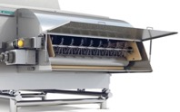


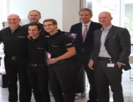







We leverage our collaborative innovation platform for Food Safety.
Bühler Innovation Board.
Partners.
Suppliers & Customers.
Employees.
Scientific community.
  4000 registered
  2000 voted
  50 trained
  Products in development

Slide 14
Developing our portfolio to build sustainable value chains.
Equipment
Processes
Service
Hygienic Design
& Engineering
Fit for purpose
compliant
cost effective
Reducing
contamination
biological, chemical, physical
Traceability
Enablers for food Safety Management
HACCP
Traceability
Sampling
From
spare parts & engineering
over
consulting & training
to
process monitoring & control

Slide 15
Bühler Solutions.

Slide 16
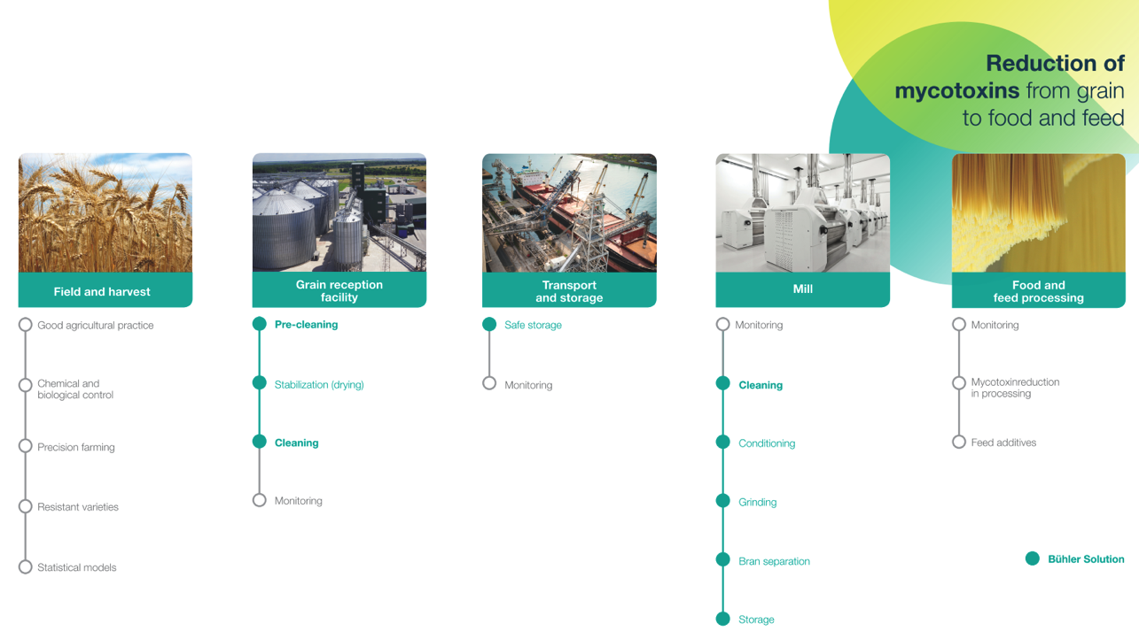

Avoid fungal infection
Inhibit fungal growth
Remove contaminated fractions
Notes:
So what is our solution? If we have a look at the value chain there are different steps and possibilities. The first thing is of course to avoid fungal infection, starting on field and harvest. Even if we follow good agricultural practice, we can´t influence the weather. Especially if there is hot and at the same time humid weather during germination and the flowering stage, the plants get probably infected. On field and harvest we as Bühler have not a real influence. But it starts at the grain reception facilities. Proper storage is very important to avoid fungal infection and also to inhibit fungal growth. Moreover drying is an important factor to stabilize the grain and to inhibit further fungal growth. However, there are sometimes already contaminated grains from the field so we have to remove the contaminated fractions through cleaning. And the earlier we do this intervention, the better, also to prevent cross-contamination and losses during storage. That means that the grain reception facilities are the first line of defense. In the mills that accurate cleaning is already quite common, but we have to bring the topic up-stream. I am convinced that the necessary pressure from the consumer towards the grain facilities will increase in the coming years.
Before I will explain you how that kind of cleaning works, let me say some words to the topic of monitoring. Up to now it is not yet marked as Bühler solution. However this is a major chance for us to develop IoT solutions and to offer IoT services like real-time analysis, detection and monitoring of mycotoxins.

Slide 17

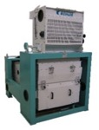



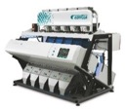

Consistent reduction of mycotoxin levels as early as possible.
Efficient cleaning technologies at grain reception.
Mycotoxin level
  Size separation: Coarse and / or small & broken kernels
  Combination of sieving machines with inlet and outlet aspiration
  GrainPlus / TAS
  Aspiration: Dust & Husks
  Density separation: Shriveled kernels
  Gravity separator
  Concentrator MTCB
  Optical sorting: Visual fungal signatures
  Optical sorting machine
  Sortex
Notes:
So this is still future, but what we can already offer is the grain cleaning work. You have to know that only a small fraction carries most of the mycotoxins. That helps us to remove these highly contaminated fractions through the combination of mechanical and density cleaning, aspiration and optical sorting. So first of all we have to use sieving machines like the GrainPlus or TAS machine to clean out coarse particles as well as small and broken kernels. Thanks to the integrated inlet and outlet aspiration we can also separate dust and light particles. That is truly necessary to reduce the mycotoxin levels because especially in the light particles and the broken kernels the concentration of mycotoxins is extremely high. If we talk about Aflatoxin reduction there is also a gravity separator like the concentrator MTCB important to get out shriveled kernels. Last but not least we always have to use an optical sorting machine to make sure that all contaminated kernels are out of the process. And here your customer can rely on the world leading optical sorting machine for grains in the field, the Bühler Sortex. So you can see here the issues of contaminated kernels on the left side and our solution on the right hand side that will help our customers to achieve a higher benefit.

Slide 18
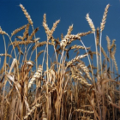
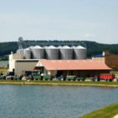

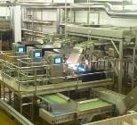
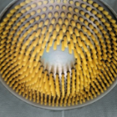
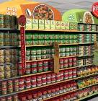
Bühler’s capabilities for foreign matter reduction.
Field & Harvest
Collection Point
Transport & Storage
Food & Feed Processing
Retail
Good Agricultural Practice
Pre-cleaning
Cleaning
Size separation
Aspiration
Density separation
Coarse cleaning
Separation
  Size separation (sieves and filtration)
  Aspiration (by air)
  Density separation (by liquids)
  Surface cleaning
  Metal Separation (magnets)
Optical Sorting
  Colour
  Near-infrared (InGaAs)
  Biochemical
  Laser
X-Ray
Manual detection and removal
Use of metal detectable plastics and rubbers
Manual inspection of integrity of a package
Good Manufacturing practice (hygienic design of equipment and facility, personnel hygiene policy, glass policy, pest control, bioterrorism policy, waste disposal, wood policy, factory cleaning procedures, sampling policy, best practices)

Slide 19
We build knowledge on microbial reduction in processing.
Example of wheat processing.
by physical separation
by thermal inactivation
bran
~ 1 log
dry cleaning
of wheat
~ 2- 4 log
thermal treatment:
flour heat treatment;
cereal flaking;
1’000’000
100’000
10’000
1’000
100
10
1
0.1
~ 1 log
milling
(low ash
flour)
wheat
> 5 log
cooking process;
extrusion
Typical microorganism load as
Aerobic Plate Count (APC) in wheat products
low ash flour
APC [CFU/g] (total No of microorganisms)
Medium
water activity
(aw 0.65 – 0.85)
High
water
activity
(aw > 0.95)
Some pathogenic microorganism like Salmonella are more heat resistant. Efficacy of Salmonella inactivation needs to be proven by validation.

Slide 20
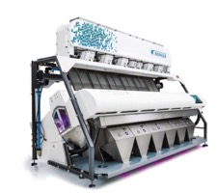
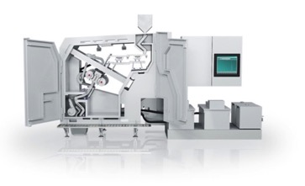
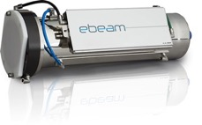


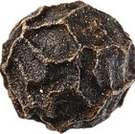


We develop new technologies for decontamination of dry foods.
LEeB technology.
Product presentation know-how
Gentle surface decontamination
Low energy electron beam
e⁻
e⁻
e⁻
e⁻
e⁻
e⁻

Slide 21
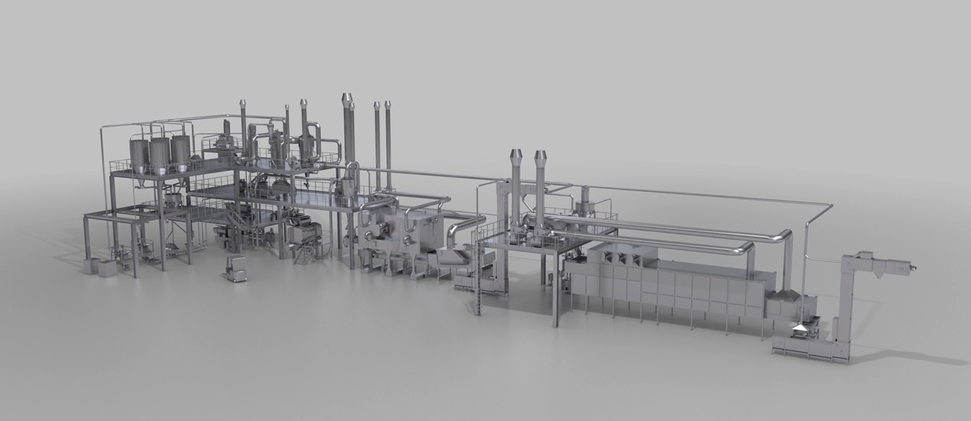
A complete hygienically designed extrusion plants is complex task.
Raw Material Handling
Dosing
Precon-ditioner
Extruder
Fluid Bed
Flaking Mill
Toasting
TUBO Conveying
Coating Drum
Dryer
Automation System
Pneumatic Lines & Airlocks
Extrusion Addition Systems
Cyclones, Filters and Fans
Roller Mills
Hammer Mills
Sifters

Slide 22
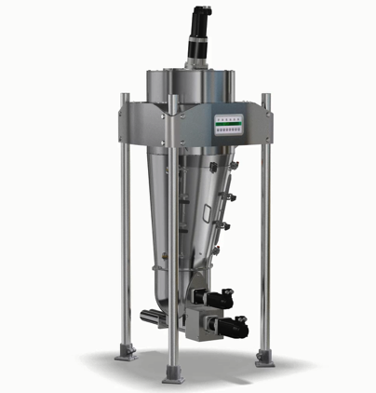
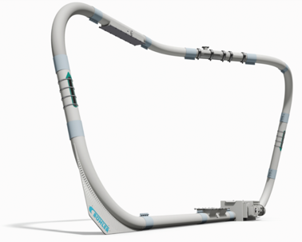
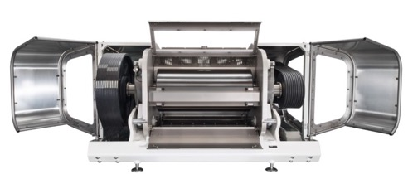
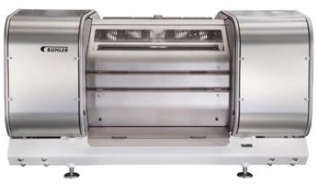
Our portfolio only fulfills partly customer’s requirements regarding HD.
Some good examples of hygienically designed products.
Stainless steel with food touching parts
Easy access for cleaning
Material certificates
Continuous weld
Kill-Step Validation
Notes:
Boxes in the lower part of slides:
“What does hygienic machine design really mean? What do customers and regulators expect?”
Some examples

Slide 23
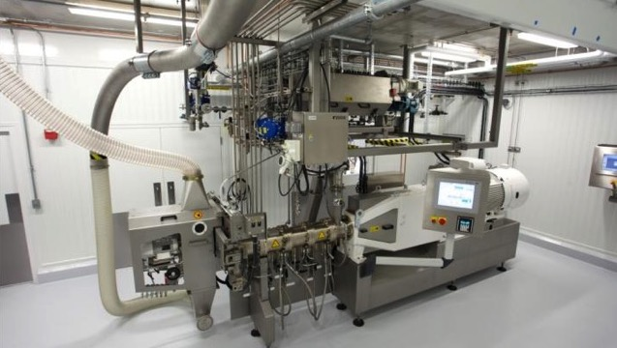
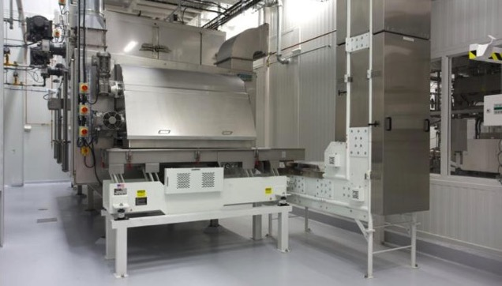
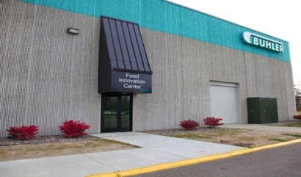
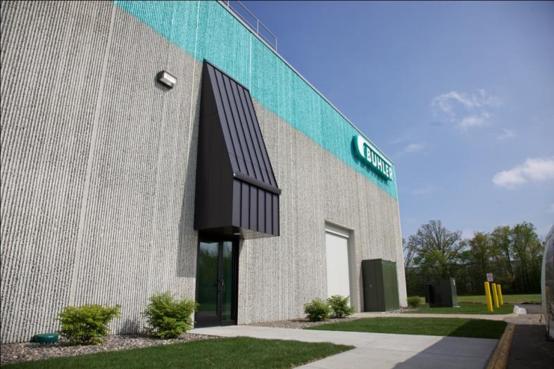


Food Innovation Center.
Opened in May 2012
Designed as a Food Grade facility to accommodate:
  Customer’s trials,
  Provide training for customers and Bühler employees
  Demonstrate Bühler’s complete solution

Slide 24
Bühler offers comprehensive Food Safety Support.
Food Safety Solutions
Extruder
Validation of Extrusion Process
Monitoring, Reporting and
Corrective Actions
IoT service
Food Safety Consultancy
Notes:
Iot service – future, not yet implemented

Slide 25
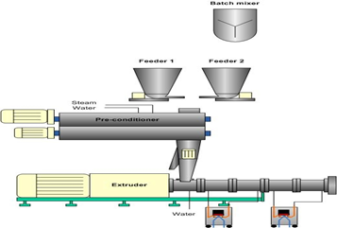
Extruder validation – microbial challenge studies.
Identification of specific pathogen of concern and surrogate
Inoculation of a raw material
Determination of log reduction needed
Introduction and recovery of inoculated material from the extruder
Determination of process conditions to be validated (worse case scenario: moisture, temperature, time, pressure, product etc.)
Validation at factory scale
Determination of critical control points
Verification and review

Slide 26
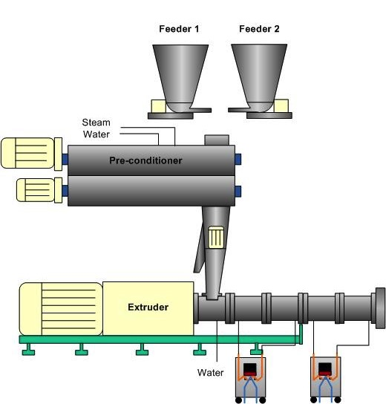



Example process set up during validation.
Feeding of inoculated material
with safe pathogen’s surrogate
Feed rate measured (kg/h)
Barrel pressure probe (Bars)
Total throughput measured (kg/h)
Temperature probes (ºC)
Pressure probe (Bars)
Drive speed (rpm)
Kg/h
Known screw configuration

Slide 27

Bread crumbs trials.
Example results.
Trial Set Up
Name | Value | Unit
Feed Rate | 500 | Kg/h
Water | 0 | Kg/h
Screw Speed | 800 | Rpm
Motor Load | 41 | %
SME | 120 | Wh/kg
Barrel Pressure | 5 | Bar
Product Temp Barrel 2. | 154 | °C
Die Block Temp. | 150 | °C
Die Block Pressure | 18 | Bar
Log₁₀ reduction
>6.4 cfu/g

Slide 28











Future: IoT monitoring solution.
Watching process with real time log kill calculations.
Monitor
Critical process parameters are monitored continuously
Adjust
Make adjustments to extrusion process quickly
Report
Generate reports to identify trends, make improvements or complete audits
Extrusion Process
Safe Food
Alert
Receive alerts when
parameters are not
being met
Store
Store production data automatically stored in a secure cloud location
Visualize
View real time production data on any web connected device

Slide 29









Avoidance of cross-contamination after the kill step.
High hygiene zone
Intake raw material & storage
Dry mixing of ingredients
Toasting & cooling
Conditioning
Extrusion
Flaking
Bagging
UNSAFE
SAFE
Hygienic plant layout
KILL STEP

Slide 30
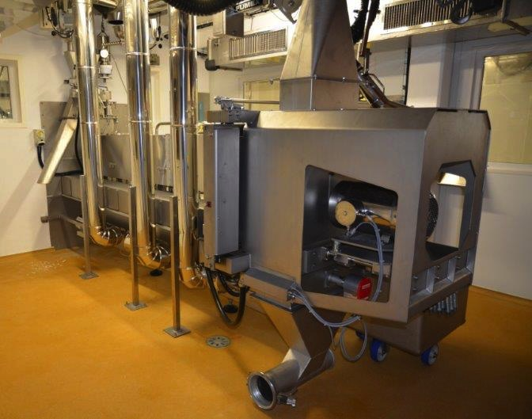
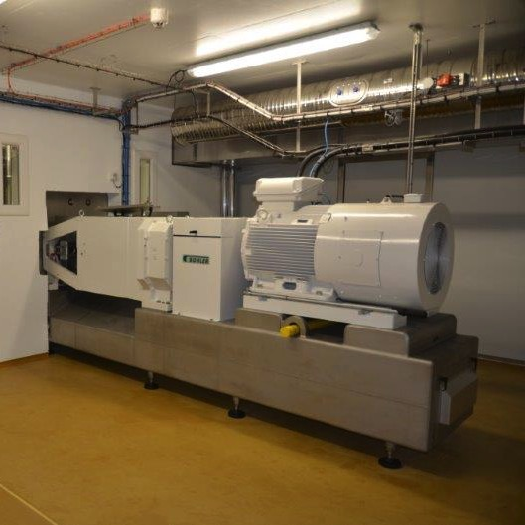
Zone segregation – division between high and medium zone.

Slide 31
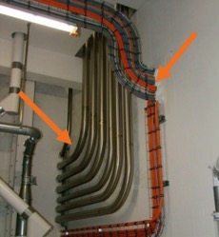
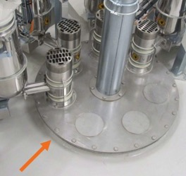
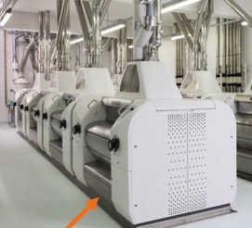
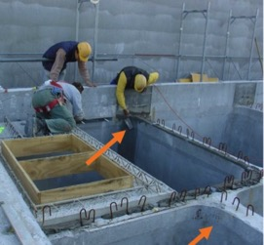
Food Safety starts with a hygienic layout of the factory.
Factory zoning
basic hygiene zone
medium hygiene zone
high hygiene zone
raw material
food ingredients
Ready-to-eat foods

Slide 32
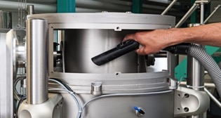
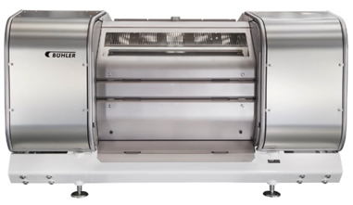







Hygienically designed equipment portfolio.
Inline check sieve MKZI
TUBEX MSDN
PolyFlakeTM
Microdosing with top
precision & hygiene, MSDF
Sanimix batch mixer
Ceres, ready-to-eat cereals dryer

Slide 33

We are leading the way in hygienic design for dry processing industry and develop internal standards.
Bühler’s 10 steps to hygienic design
Understand processing purpose
Understand cleaning requirements
Define hygiene level
Understand relevant food safety hazards
Follow relevant industry regulations and hygienic design guidelines
Select construction material: fit for purpose & compliant
Design: solve the multi-requirement equation
Define manufacturing specification
Define installation requirements
Provide the documentation

Slide 34
Automation Solutions.

Slide 35



Protect your food production and increase the process quality.
Intake
Product identification
Extruder
Machine Control
Challenges for the food industry
Maintenance
ProPlant
Plant control
Functions
Logistic
&
Traceability
Drying / Roasting
Validation Service
Hygienic Design
Cabling
Food Safety.
Notes:
GAutNavFood

Slide 36

Automation.
The key enabler for food safety.
Data
Logging
  Data logging minimizes paper work – Easier data management
  Due diligence documentation
  Traceability functionality builds transparency in the value chain – Knowing the content of every batch
  User management for authentication and logging of operation activities – Traceability of operation
  Control and monitoring of bacteria kill steps (and other critical steps) - Product recalls are cost intensive
Trace-ability
Operation
Log
Risk Reduction

Slide 37


Operational Historian.
Full transparency of production.
Benefits
Support of quality officers to be compliant with norms and regulations.
Full transparency about the production in the past.
Less paperwork required because reports are generated computer based.
Function
Powerful SQL database for a long-term saving of production data.
Values for quality assurance and food safety are recorded and documented.
Displayed errors and messages as well as user interactions are archived.
Batch related reports enable transparency of the production.
Visualization of historical or current data with configurable trend charts.
Audit log
What
Who
When
Why
Previous value
Notes:
Additional Information
With the long term history, trends, reports etc. can also be generated for data in the past.
Other systems in the market deliver only trends and reports for the actual production, or need an interface to a separate system.

Slide 38

Traceability and Logistic.
WinCos® logistic & trace modules.
Challenge
    Is product transparency ensured?
    Which components are really in the finished
    product?
Answer of Bühler
    All components and products are tracked.
    Products and components can be traced forward or backwards.
    Management of product lots brings deeper transparency.
    Warehouse management tracks bound products (bags
    or pallets) from I-Point until distribution point.

Slide 39

Automation solutions: Traceability.
Proof of traceability along the entire supply chain.
Benefit
Ensure products transparency with the exact content of finished products until the single ingredient component lot.
Food safety related production issues are transparent
Be sure the right ingredient components are added.
Function
Holistic and user friendly overview of incoming to outgoing goods and vice versa.
All process steps are completely registered and saved in a central database
Traceability of the product lots in the silo layers.
Audit log of each user interaction
Bar code identification verifies the right ingredient components of the production
Audit log
Notes:
Additional Information
Product Traceability
Continous and user friendly overview from delivery back to receivals
All process steps completely registered and saved in a centralized database
Allows traceability view based on receivals, deliverys or production steps
Registering of silo layers
Registering of single product lots
Audit Log
Every user interaction is logged
Food safety related production issues are transparent
Effective filter function for fast localisation operation issues
Classification and description of operation issues
Identification systems
Bar code identification verifies the right ingredient components of the production
Labeling of bags or pallets enables product tracking in the warehouse with bar code identification
Batch related labeling of pre-weighed ingredients supports operators to add previous prepared hand additions to the corresponding batch
User authentication with RFID badge cards at operation stations

Slide 40

WinCos® plant control (MES).
Modules for data logging.
Challenge
    Are all production batches transparent?
    Bacteria have been killed demonstrable?
    Necessary parameter changes are documented
    and authorized?
    Every batch is recorded in a sustainable database.
    Batch trending with printable reports and adaptable
    trend charts.
    Logging of every user interaction - what, who, when,
    why, previous value.
    User authorization with scalable user
    management.
Answer of Bühler

Slide 41


WinCos® plant control (MES).
Contamination prevention modules.
Challenge
    Is the machinery clean and ready for the next production batch?
    Are quality topics aligned between production (WinCos®) and laboratory (LIMS)?
Answer of Bühler
    WinCos® has a contamination control module that locks unwanted production.
    WinCos® allows an automatic synchronization of quality relevant data, since it interacts with external systems (ERP, LIMS). This results in an interlocked production if the components had been interlocked in the LIMS.
Notes:
Quittirung von Reinigungsschritten (oder Frage Hände gewaschen?)
Operational Prerequisits (OPRQ)

Slide 42

Hygienic Design.
Minimization of deposits.
Challenge
    Could the product be contaminated by electrical equipment or its deposits?
    Are all surfaces, which allow deposits well cleanable?
Answer of Bühler
    Vertical installation with basket tray to avoid dust accumulation.
    Reduction of closed surfaces, as trucking systems and conduit installations, and focus on better cleanable installation methods, as field boxes (due to less cables).
    Touch screen control panels are easily cleaned

Slide 43

Food Safety is part of our promise to engineer customer success.
ENGINEERING
CUSTOMER SUCCESS.

Slide 44
Engineering Customer Success.
www.buhlergoup.com

